Slide 1
Business Analytics
Session 1

Slide 2

GAME PLAN
Introductions
The “Zoo” of Analytics
Predictive Analytics: Forecasting

Slide 3
GAME PLAN
Introductions
The “Zoo” of Analytics
Predictive Analytics: Forecasting

Slide 4

Introductions

Slide 5
Instructor
Evgeny Kagan, PhD
Research-track faculty at Carey
ekagan@jhu.edu
Office hours:
Mondays 5-6pm (Zoom)

Slide 6
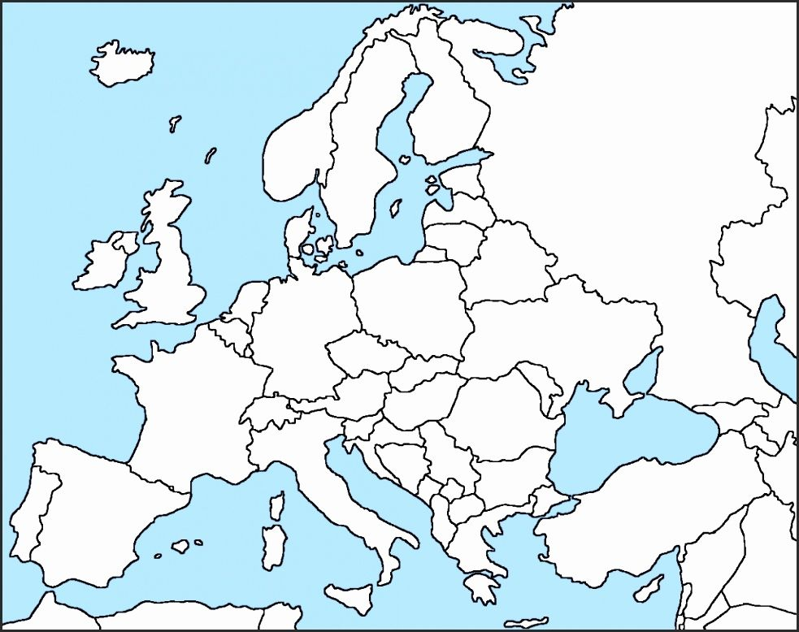
A bit about me..

Slide 7

A bit about me..

Slide 8

A bit about me..
Mannheim University

Slide 9
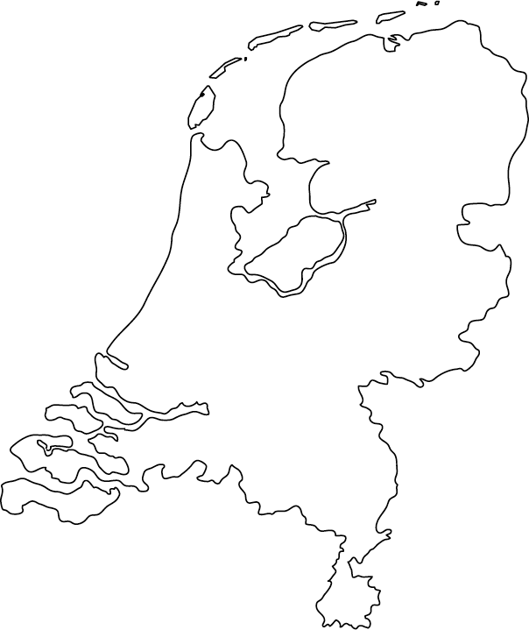

A bit about me..
Rotterdam

Slide 10
A bit about me..

Slide 11


A bit about me..

Slide 12



Behavioral economics
My research interests

Slide 13
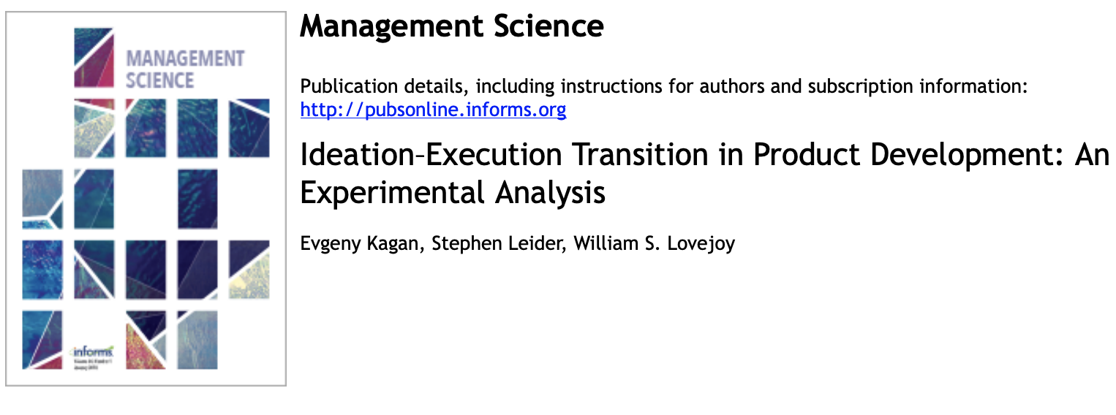

Some of my work
+

Slide 14

Teaching assistant
Jiaye Li
jiayeye28@gmail.com
Office hours: by appointment

Slide 15



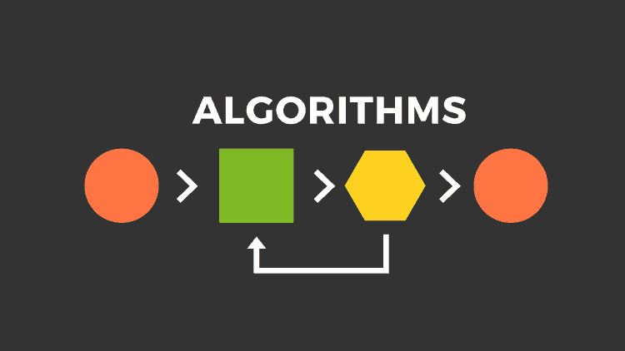
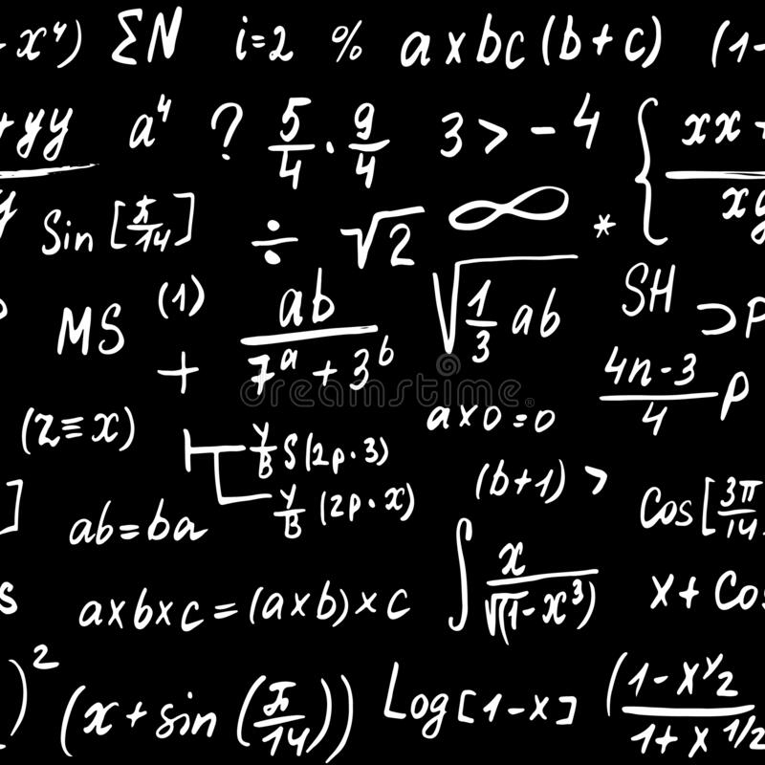




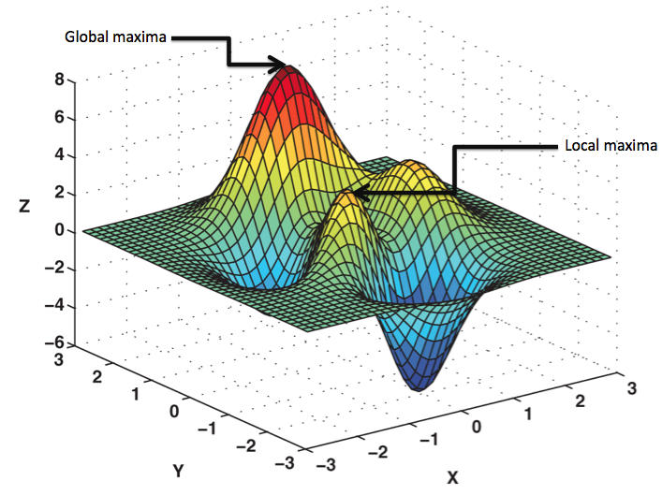
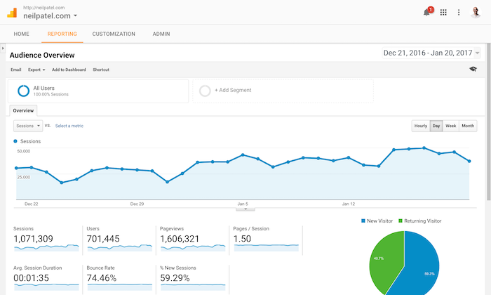

What Does Business Analytics Mean To You?
1
4
7
10
2
5
8
11
3
6
9
12

Slide 16
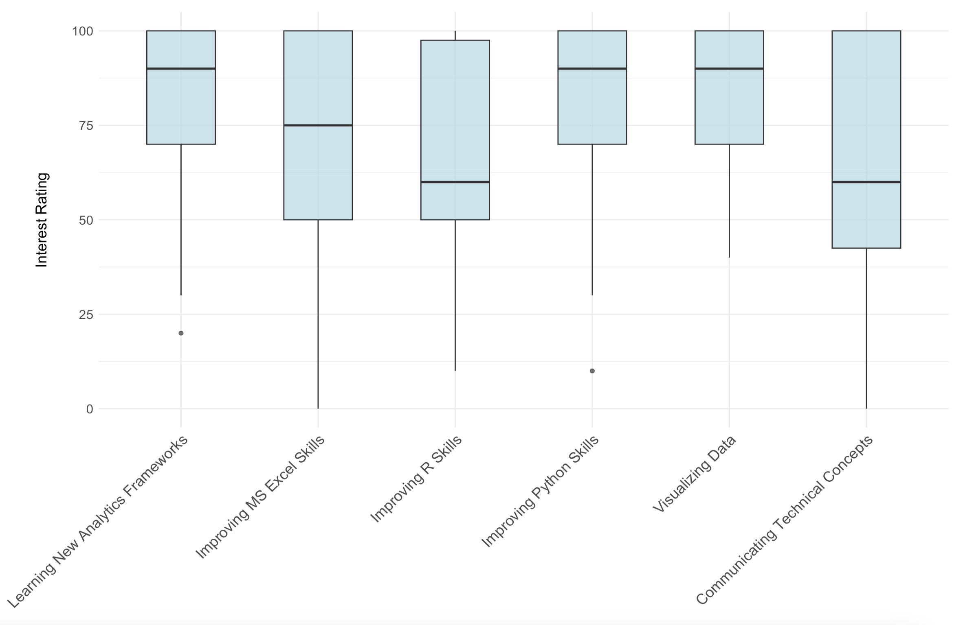
Your Interests (N=33, T1 and T2 sections combined)

Slide 17
Your Interests (N=33, T1 and T2 sections combined)

Slide 18
Your Interests (N=33, T1 and T2 sections combined)

Slide 19
GAME PLAN
Introductions
The “Zoo” of Analytics
Predictive Analytics: Forecasting

Slide 20

Definitions
What is analytics?
Definition: Analytics is the use of mathematics to analyze data

Slide 21
Business Analytics
Data
Analytics (Modeling)
Story/
Visualization

Slide 22
Business Analytics
Data
Analytics (Modeling)
Story/
Visualization
This class! (Mostly)

Slide 23

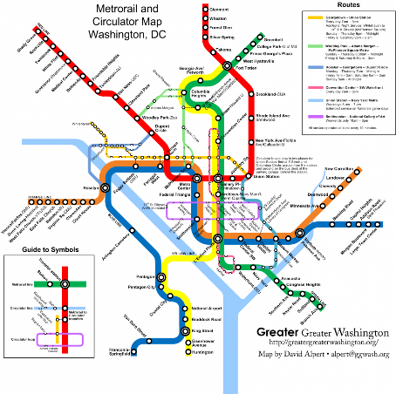
Models
A model is a selected abstraction of reality

Slide 24
Model/Analytics Taxonomy
Prescriptive Models
Predictive Models
How do we make good things happen?
Value
Diagnostic Models
What will happen next?
Descriptive Models
Why did it happen?
What happened?
Extract, Transform, Load (ETL)
Difficulty
Source: Gartner, IBM, many others.

Slide 25
Model/Analytics Taxonomy
Prescriptive Analytics
Predictive Analytics
How do we make good things happen?
Value
Diagnostic Analytics
What will happen next?
Descriptive Analytics
Why did it happen?
What happened?
Extract, Transform, Load (ETL)
Difficulty
Source: Gartner, IBM, many others.

Slide 26
Model/Analytics Taxonomy
Artificial Intelligence
Prescriptive Analytics
Predictive Analytics
How do we make good things happen?
Value
Diagnostic Analytics
What will happen next?
Descriptive Analytics
Why did it happen?
What happened?
Extract, Transform, Load (ETL)
Difficulty
Source: Gartner, IBM, many others.

Slide 27
Model/Analytics Taxonomy
Value
How can we collect, organize, and learn from social media data? How can we merge data from multiple sources?
Extract, Transform, Load (ETL)
Difficulty
Source: Gartner, IBM, many others.

Slide 28
Model/Analytics Taxonomy
Descriptive stats (avg, variance, range, …)
Data tables
Data visualization and dashboards
Value
Descriptive analytics
E.g. banking industry:
How many loans are in good standing? How many are in default? What are the features of loans in default?
What happened?
Difficulty
Source: Gartner, IBM, many others.

Slide 29
Model/Analytics Taxonomy
Hypothesis testing
Statistical analysis
Regression
Value
Diagnostic analytics
E.g. banking industry:
What are the key drivers of loans in default? Are older people more likely to repay loans?
Why did it happen?
Difficulty
Source: Gartner, IBM, many others.

Slide 30
Model/Analytics Taxonomy
Forecasting
Machine Learning
Classification
Predictive analytics
Value
What will happen next?
E.g. banking industry:
Who are the people more likely to repay the loans? Can we identify fraudulent credit card transactions in real time?
Difficulty
Source: Gartner, IBM, many others.

Slide 31
Model/Analytics Taxonomy
Prescriptive analytics
Optimization
Simulation
How can we make good things happen?
Value
How should we design our loans to minimize defaults? Who should we give loans to?
Difficulty
Source: Gartner, IBM, many others.

Slide 32
Model/Analytics Taxonomy
Artificial Intelligence
Autonomous systems
Multi-armed bandit
Value
How can we design an algorithm that automatically figures out what types of loans and who to give loans to, as market conditions change?
Difficulty
Source: Gartner, IBM, many others.

Slide 33

Using Qualtrics Survey Data…
Value
Extract, Transform, Load (ETL)
Difficulty

Slide 34
Using Qualtrics Survey Data…
Value
Descriptive Analytics
Difficulty

Slide 35
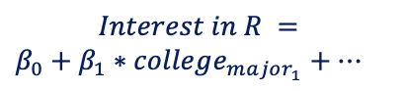
Using Qualtrics Survey Data…
$$Interest in R =$$ $β_{0}+$ $β_{1}∗college_{major_{1}}+…$
Value
Diagnostic Analytics
Difficulty

Slide 36
Using Qualtrics Survey Data…
Predictive Analytics
Can I predict individual student success based on their background and interest?
Value
Difficulty

Slide 37
Using Qualtrics Survey Data…
Prescriptive Analytics
How can I optimize the course to ensure maximal learning and enjoyment?
Value
Difficulty

Slide 38


Model/Analytics Taxonomy
Looking back
Looking ahead
Prescriptive Analytics
Predictive Analytics
How do we make good things happen?
Value
Diagnostic Analytics
What will happen next?
Descriptive Analytics
Why did it happen?
What happened?
Extract, Transform, Load (ETL)
Difficulty

Slide 39
Model/Analytics Taxonomy
Artificial Intelligence
Prescriptive Analytics
Looking back & ahead
Predictive Analytics
How do we make good things happen?
Value
Diagnostic Analytics
What will happen next?
Descriptive Analytics
Why did it happen?
What happened?
Extract, Transform, Load (ETL)
Difficulty

Slide 40

Work on homework problems as we cover them
Don’t fall behind on group project
Reach out for help if you are having trouble

Slide 41

Analytics: Breakout discussion
https://algorithms-tour.stitchfix.com/
Category/ model | Type of analytics | Why?
1. Warehouse assignment | Prescriptive | Assigning a warehouse is about choosing (“prescribing”) which warehouse to use for each shipment
2. Recommen-dation systems … | … | …
Notes:
https://www.youtube.com/watch?v=Bqc9GfB8oa4

Slide 42

Break Outs
Fill in the yellow highlighted cells in Google doc
Choose a spokesperson to present results
Notes:
Group 1: https://docs.google.com/document/d/1TEbmuFIthG3Tbmv7OdtzD5rxHvMO3lJOR806vPK1zY4/edit
Group 2: https://docs.google.com/document/d/1zvyaS5Bjs4kAlFF7jigdHfogQ3W8-Gm19VluKPyElo4/edit
Group 3: https://docs.google.com/document/d/1iAKI9d6or786EWornqvf4SeS6p1H8BvIFaAp8oAO-8o/edit
Group 4: https://docs.google.com/document/d/1TM9JkcDmWO2W3ePFeahfQlcWOH6g5xvjDzyizFw0iso/edit
Group 5: https://docs.google.com/document/d/1Sykb4T8SWnRQRTTh6QtH3s58PsO361chE-1p5od3ugw/edit
Group 6: https://docs.google.com/document/d/1tQo-T87jP5ZgfMD0z6NoGX_RLbKjzLOHajIo8Is4fDo/edit
Group 7: https://docs.google.com/document/d/1BRmuL4e3eewE_QPR3tjLo5cr6MfeZ5JqZGtaeNCwQQ4/edit
Group 8: https://docs.google.com/document/d/1uRIpHAAodL73k_W2-UZfU-WUFmKPLw31nswplEGcqYg/edit
Group 9: https://docs.google.com/document/d/1UrsbjFRkVzfMSwwxiIh3kCVMcjPfIPTM7gH2qPBngRg/edit

Slide 43
Analytics: Breakout discussion
 | Type of analytics | Explanation
1. Warehouse assignment | Prescriptive | Assigning a warehouse is choosing (“prescribing”) which warehouse to use for each shipment.
2. Recommendation systems | Predictive | Evaluate match based on client and product characteristics
3. Matchmaking | Prescriptive | Assigning based on optimal match
4. Human computation | Not analytics | Stylist’s input
5. Logistics optimization | Prescriptive | Optimize delivery is about prescribing/deciding
6. State machines | Descriptive/Predictive | Summarizing current customer type, and trying to anticipate changes
7. Demand modeling | Predictive | Try to forecast for each type what product they will want most
8. Inventory management | Prescriptive | Optimize (or simulate) how much of each type of product to order and stock
9. New style development | Descriptive/Predictive/Prescriptive | Document current styles, change them based on sales data, develop new style
10. Data platform | ETL/Descriptive | Prepare the data so that others can use it

Slide 44
Analytics
Artificial Intelligence
Prescriptive Analytics
Predictive Analytics
Value
Diagnostic Analytics
Descriptive Analytics
BU.501.601 (Statistics)
BU.510.650 (Data Analytics)
Extract, Transform, Load
Difficulty
Source: Gartner, IBM, many others.

Slide 45
Analytics
Artificial Intelligence
Prescriptive Analytics
Predictive Analytics
THIS CLASS!
Value
Diagnostic Analytics
Descriptive Analytics
Extract, Transform, Load
Difficulty
Source: Gartner, IBM, many others.

Slide 46
Analytics
Artificial Intelligence
Prescriptive Analytics
BU.520.710 AI Essentials for Business
Predictive Analytics
Value
Diagnostic Analytics
Descriptive Analytics
Extract, Transform, Load
Difficulty
Source: Gartner, IBM, many others.

Slide 47
Analytics
Artificial Intelligence
Prescriptive Analytics
Predictive Analytics
Value
Diagnostic Analytics
Descriptive Analytics
BU.450.765 (Social Media Analytics), BU.330.770 (Database Management)
Extract, Transform, Load
Difficulty
Source: Gartner, IBM, many others.

Slide 48
Class Overview
Artificial Intelligence
Prescriptive Analytics
Predictive Analytics
Optimization (II, III) Risk modeling (IV, V)
Value
Diagnostic Analytics
Forecasting (I)
Simulation (V, VI)
Descriptive Analytics
Extract, Transform, Load
Difficulty
Source: Gartner, IBM, many others.

Slide 49
Course Grading
5%
5%
30%
20%
40%
Attendance
Participation
Homeworks (5)
Group Project
Final Exam

Slide 50

Attendance and Participation
Attendance (5%)
One absence excused. Lose 2 pts on final grade for each additional absence.
Participation Points (5%)
- Class activity
- (Non-) participation in group discussion

Slide 51
Homework
Homework 1 (6%) Covers: Excel/Forecasting. Due before session 2
Homework 2 (6%) Covers: Optimization. Due before session 3
Homework 3 (6%) Covers: Optimization II. Due before session 4
Homework 4 (6%) Covers: Risk modeling. Due before session 5
Homework 5 (6%) Covers: Simulation. Due before session 6

Slide 52

Group Projects
Interview a manager of your choice to understand an analytics problem faced by their organization
Apply the “analytic” way of thinking to their problem
Make use of forecasting, optimization, risk modeling and simulation (at least one method) to propose an analytic solution

Slide 53
Group Project Deliverables
Group Project (20%)
Proposal due session 3 (2%)
Summary of interview due session 5 (2%)
Presentations during first half of session 7 (16%)
… details on Canvas

Slide 54

Course Grading: Final Exam
Final Exam (40%)
Written Exam: open book, open notes
3 hours
Exam review in session 7

Slide 55
Work on homework problems as we cover them
Don’t fall behind on group project
Reach out for help if you are having trouble

Slide 56
GAME PLAN
Introductions
The “Zoo” of Analytics
Predictive Analytics: Forecasting

Slide 57
Class Overview
Artificial Intelligence
Prescriptive Analytics
Predictive Analytics
Value
Diagnostic Analytics
Forecasting (I)
Descriptive Analytics
Extract, Transform, Load
Difficulty
Source: Gartner, IBM, many others.

Slide 58




The four Ingredients of Analytic Problems
Objective?
Risks?
Decision?
Constraints?

Slide 59
Generalized Analytics Procedure (GAP)
Define Model in Words
O: Objective
R: Random Variables
D: Decision Variables
C: Constraints
Formulate Model Mathematically
D: Define Decision Variables
R: Define Random Variables
O: Define Objective Function (in terms of Decision and Random Variables)
C: Define Constraints (in terms of Decision Variables)
Solve (manually or using software)

Slide 60
Australian Beer Production
Quarter | Actual (Megalitres)
1990 Q1 | 485
1990 Q2 | 441
1990 Q3 | 429
1990 Q4 | 599
1991 Q1 | 464
1991 Q2 | 424
1991 Q3 | 436
1991 Q4 | 574
1992 Q1 | 443
… | …
… | …
2006 Q4 | …
Quarter | Predictions (Megalitres)
2007 Q1
2007 Q2
2007 Q3
2007 Q4
2008 Q1
2008 Q2
2008 Q3
2008 Q4
2009 Q1
2009 Q2
2009 Q3
2009 Q4

Slide 61
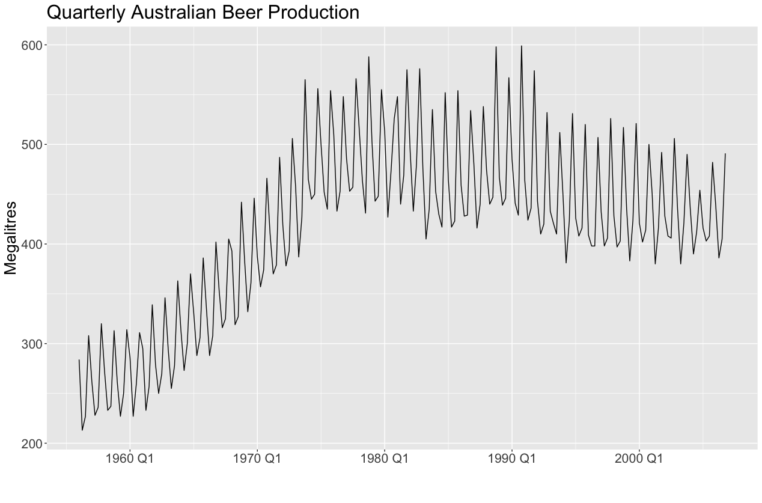
Australian Beer Production 1956-2006

Slide 62

Forecasting Example
?
Notes:
Training data set (omits 2007-2010 observations)

Slide 63
Generalized Analytics Procedure (GAP)
Define Model in Words
O: Objective: what are we trying to achieve?
R: Random Variables: what are the unknowns/risks?
D: Decision Variables: What will you calculate/solve for?
C: Constraints: What are the values that decision variables can(not) take?
Predict beer production volume in Q1-Q4, 2007-2009
Beer production volume in Q1-Q4, 2007-2009
Predictions for Beer production volume in Q1-Q4, 2007-2009
Prediction numbers must be non-negative – cannot drink negative amounts of beer

Slide 64
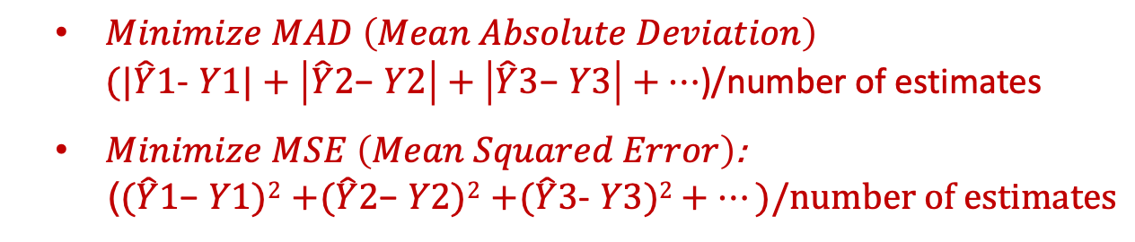
Generalized Analytics Procedure (GAP)
Formulate Model Mathematically
D: Define Decision Variables
R: Define Random Variables
O: Define Objective Function (in terms of Decision and Random Variables)
C: Define Constraints (in terms of Decision Variables)
$\hat{Y}1$, $\hat{Y}2$, $\hat{Y}3$, $\hat{Y}4$ etc… for beer mgl. each year/quarter
$Y1$, $Y2$, $Y3$, $Y4$ etc… for beer mgl. each year/quarter
$Minimize MAD \left(Mean Absolute Deviation\right)$ $(|\hat{Y}1$- $Y1|+\left|\hat{Y}2\text{−} Y2\right|+\left|\hat{Y}3\text{−} Y3\right|+…$)/number of estimates
$Minimize MSE \left(Mean Squared Error\right)$:
($(\hat{Y}1\text{−} Y1)2$ $+(\hat{Y}2\text{−} Y2)2$ $+(\hat{Y}3$- $Y3)2+…)/number of estimates$
$$\hat{Y}1≥0, \hat{Y}2≥0, \hat{Y}3≥0 …etc$$

Slide 65

Forecasting Methods
Let’s try the following forecasting methods:
Naïve: use the last observation
Drift: use the average trend over all observations
Simple Average (mean): use average of all previous observations
Seasonal Average (mean): use quarterly averages

Slide 66
Forecasting Example: Naïve Method
Naive

Slide 67
Forecasting Example: Drift Method
Drift

Slide 68
Forecasting Example: Drift Method
Mean

Slide 69
Forecasting Example: Drift Method
Seasonal Mean

Slide 70
Break Outs

Slide 71
Break Out Task
Your task:
Apply Seasonal Naïve method: use the four last available data points (Q1 2006, Q2 2006, Q3 2006, Q4 2006) to predict 2007-2009 quarterly volumes.
Calculate MAD/MSE: how do the results compare to “Seasonal Average”?

Slide 72
Next week
Artificial Intelligence
Prescriptive Analytics
Predictive Analytics
Optimization (II, III)
Value
Diagnostic Analytics
Forecasting (I)
Descriptive Analytics
Extract, Transform, Load
Difficulty
Source: Gartner, IBM, many others.

Slide 73
Homework 1
Excel functions (SUMPRODUCT, graphing) and forecasting
Due: before Class 2
6% of final grade; late submissions receive a 2pt per day deduction.

